Slide 1
Integrations with the Force.com Platform using Custom Apex REST Services
Designing Apex REST services for cross-platform usability
Andy Boettcher, Salesforce MVP
Chief Technical Architect, Demand Chain Systems
@andyboettcher

Slide 2




Andy Boettcher Chief Technical Architect Demand Chain Systems
4x Salesforce MVP
Co-leader, MN Developer Group 11 Salesforce Certifications

Slide 3
Overview
What should you expect from this session?
What you will be learning
Architecture
Apex REST class
Request / Response inner classes
Multiple routing actions without use of REST OPTIONS
WAIT! What about clicks before code??!
Summary and recap
Q&A

Slide 4
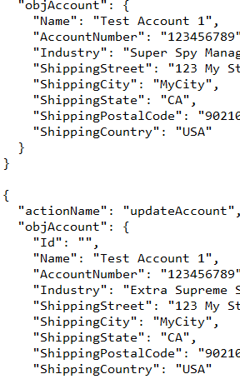
What you will be learning
Standardization
REST and JSON = standard
External systems do not need platform knowledge

Slide 5
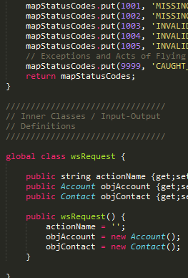
What you will be learning
Building forward
Context-appropriate responses
Automatic synchronization with object metadata
Quick and easy to implement

Slide 6
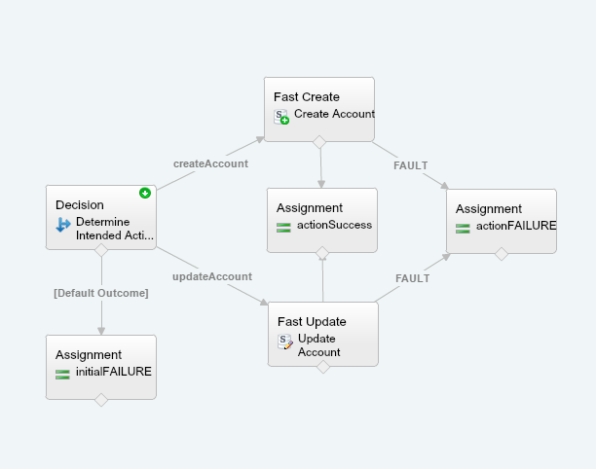
What you will be learning
Enabling the business
Control of business process vs. full API access
Let your business take the wheel

Slide 7
Architecture
How does this actually fit together?
Request Object
Salesforce
External System
REST Processor
Response Object

Slide 8
Code sample #1
Inner classes, request/response

Slide 9
Code sample #2
Apex REST handler and action routing

Slide 10
Code demo
Put it all together!

Slide 11

Leverage the platform!
Take that next step
“Clicks before code”
Why lock yourself into all ingoing maintenance?
Provide the framework, let the users grow use cases
Move the business logic to Flow!

Slide 12
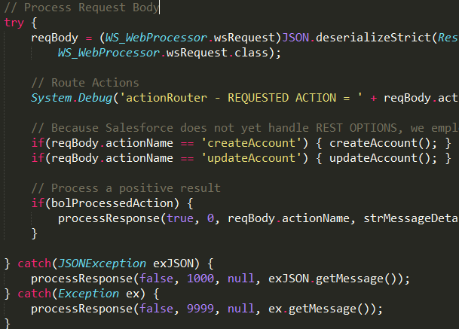
Flow Demo
Power of Flow vs. raw Apex code
Static
Maintained by YOU
Extend/Rollback by code deployments
Apex Unit Tests for each use case
Dynamic
Maintained by THEM
Extend/Rollback by Flow versions
Only one Apex Unit Test

Slide 13
Flow demo
Empower the business declaratively!

Slide 14

Summary and recap
What should you be walking away with?
Ideas!!
Integrate with REST-capable external systems
Business process focus vs. raw API
Future-proof
Extensible
Leverage the platform and expand adoption!
http://github.com/techman97

